Slide 1
Molecular orbital theory: octahedral complexes
Shape of Ligand Orbitals

Slide 2
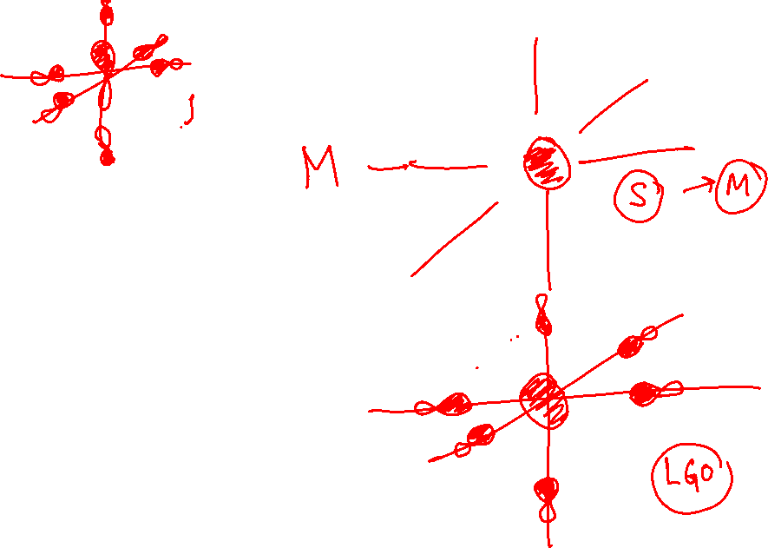

Slide 3


